Slide 1
C programming Review
Lecture 2

Slide 2
Introduction
Variable
Conditional statements
Iteration (while, for….)

Slide 3
Declare Variables
A variable is a location in memory that is referred to by its name, it can store a value of particular data_type and it has an address.
Variable must be declared before they can be use; the format is
Data_type variable_name; e.g. Int var1

Slide 4
Format specifiers for printf.
There are quite a number of format specifiers for printf. Here are the basic ones :
%d print an int argument in decimal
%ld print a long int argument in decimal
%c print a character
%s print a string
%f print a float or double argument
%e same as %f, but use exponential notation
%g use %e or %f, whichever is better
%o print an int argument in octal (base 8)
%x print an int argument in hexadecimal (base 16)
%p print the value of a pointer in its hex format
%% print a single %

Slide 5
Input/ output
There are numerous was to input data via the keyboard:
scanf(“%d”, &input) (explain this code)
Input = getchar();
gets(input); Better to use fgets(ArrayName, Array_Size, stdin)
There are numerous was to output data via the keyboard:
printf(“ the value of the input is: %d”, input);
putchar(input);
puts(input); (how does this differ from printing a string via printf)
It is important to remember that you write a program two sets of people the end user and a programmer:
For an end user: “appropriate prompt” ; scanf; flushall;
For the programmer what would you do?

Slide 6
Conditional Statements
A conditional statement?
Relational expressions and Boolean operators ( give an example of each?)
Types of conditional statements:
If (condition){
Set of statements….
}
If (condition)
{
Set of statements
else
{
Set of statements;
}
switch statement : how does it work?

Slide 7
Iteration statements
What is the purpose of iteration statements?
Main types of Iteration statements are:
While ; do while and for loop;
Distinguish between each one and give an appropriate example as to where they may be used?
What are the 3 Important steps associated with iterational statements:

Slide 8
What does the following code
do
{
printf("enter an integer between 1 and 20: ");
scanf("%d%",&value_square);
fflush(stdin);
}while ((value_square < 1) || (value_square > 20));

Slide 9
What does the following code do?
while (row_counter < value_square)
{
while(col_counter < value_square)
{
printf("* ");
col_counter ++;
}
printf("\n");
row_counter ++;
col_counter = 0;
}
}

Slide 10
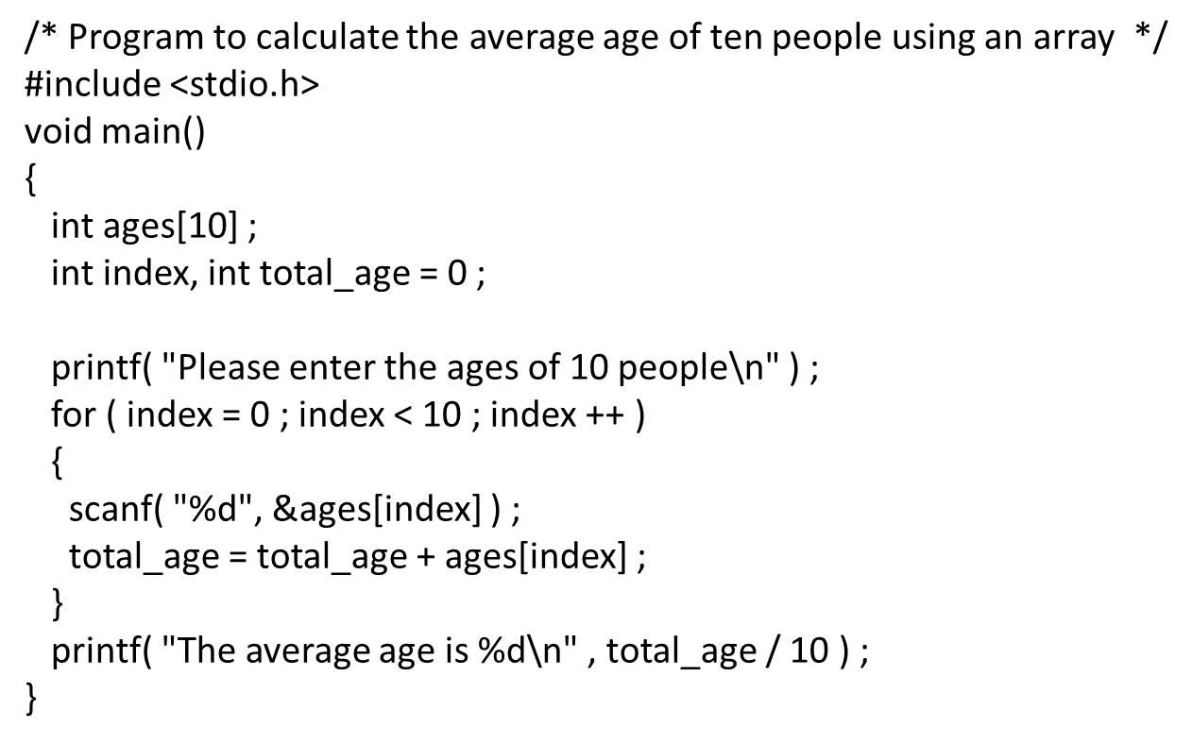
Calculating average using arrays

Slide 11
Compile and run program in linux
Need to use the gcc compiler
To compile (go to directory using cd)
gcc –o output_file input_file.c
To run the program
./output_file
Note - o out_file is optional and if not used the output (the executable file is called a.out)

Slide 12
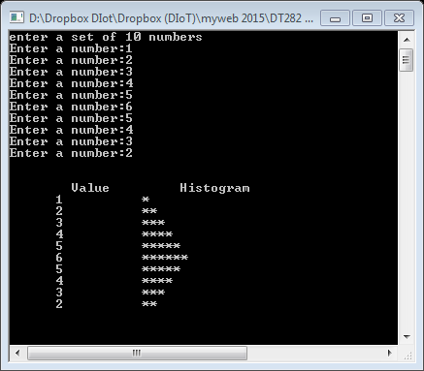
Class Question Histogram
/* Histogram printing program
This program asks the user for 10 numbers and store these in an array.
The numbers in the array are then processed to graph the information in
the form of a bar chart or histogram - each number is printed, and then
a bar consisting of that many asterisks is printed beside the number */

